Slide 1
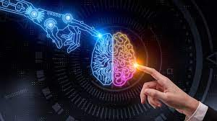


COE292 – Final project Resume Parser Done by/ Group 3
Group members:
1- Shabib Aldawsary
2- Yaman Shullar
3- Tariq Madkhali
4- Sultan Mashyakhi

Slide 2

Problem Statement
The main problem is → People who stuff a lot of key words in their resumes
Why is it a problem? → Wastes a lot of time on skimming
Dataset used in this project: taken from Kaggle, it contains the job title and the resume information of the candidate

Slide 3
Algorithms Used in this Project
Requirements to select the algorithms (Reasons to select):
1- Can differentiate a stuffer and a non-stuffer (classify)
2- Can group key words for each domain (cluster)
3- Can separate candidates based on their favorability
Decision:
1- SVM
2- K-NN

Slide 4
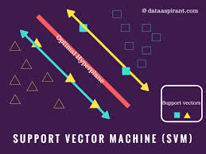
SVM in General (For classification)
How it works?
It finds a hyperplane to separate N features (also the number of dimensions), specifically, it finds the maximum margin
Why is it good?
It produces significant accuracy with less computation power.

Slide 5

SVM in the Project
Distinguishes between stuffers and non stuffers (classify)
How?
Checks the number of words in each resume:
1- words after (Description) > 600 word?
2- words before (skills details) > 125 word?
Decision → Stuffer

Slide 6
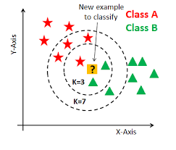
K-NN in General (for clustering)
How it works?
Test each sample for similarity with each record in the set, then classify it to the most common records (cluster) among the nearest N records
Why is it good?
Lazy learner → instances themselves represent the knowledge
Very fast in training

Slide 7
K-NN in the project

Slide 8
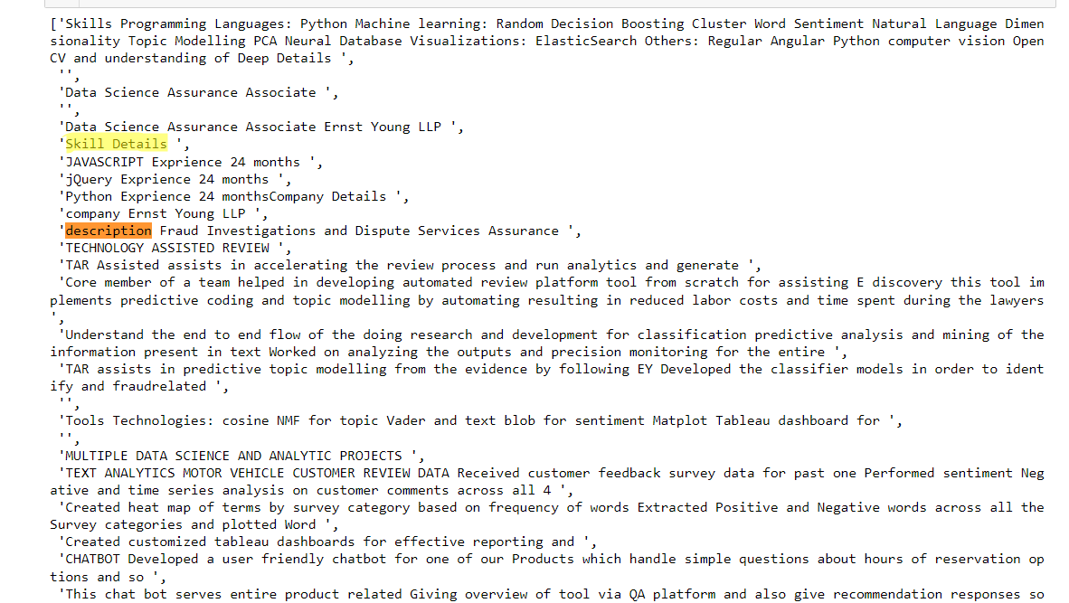
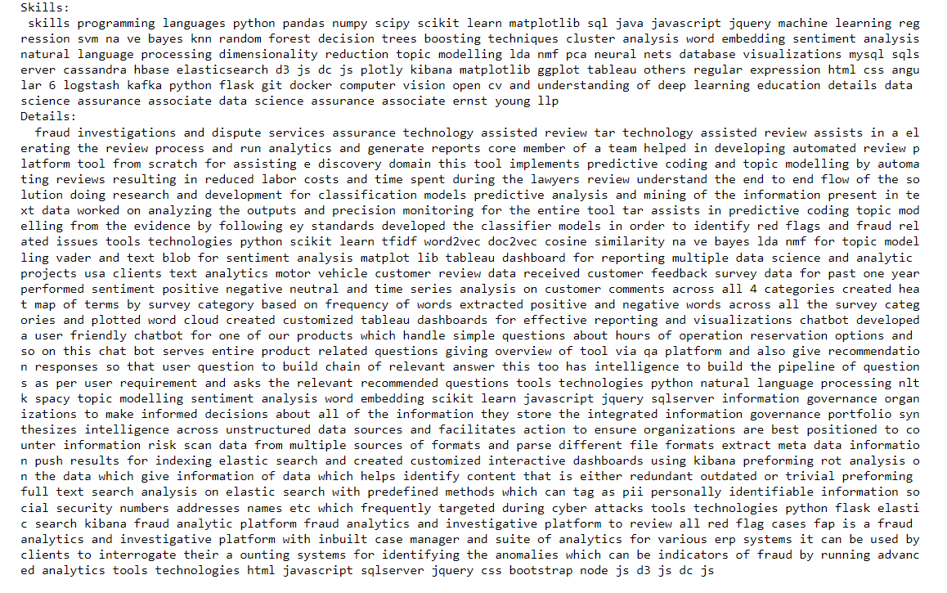
SVM Results

Slide 9
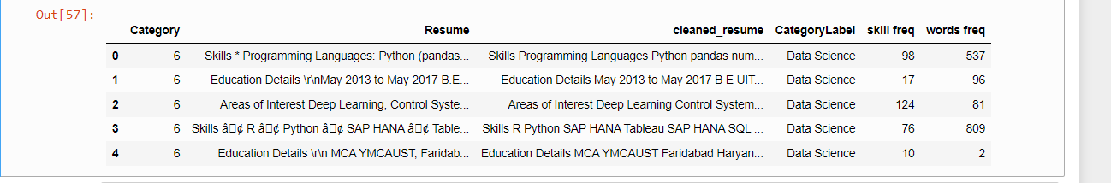
Results (continued)

Slide 10
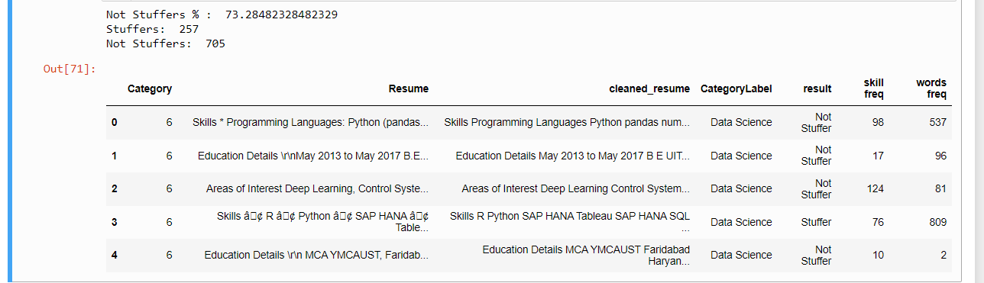
Results (continued)

Slide 11
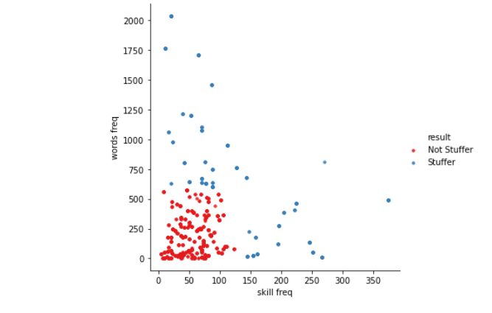
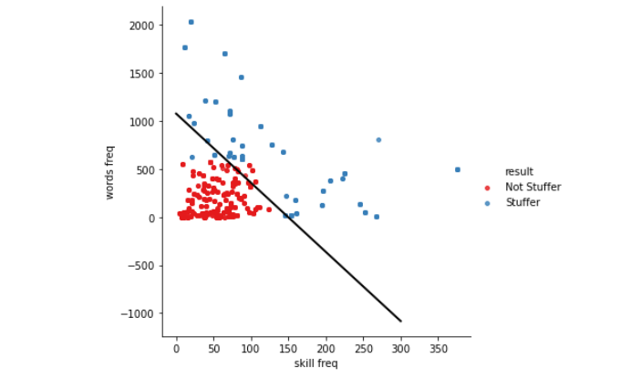
Results (continued)

Slide 12
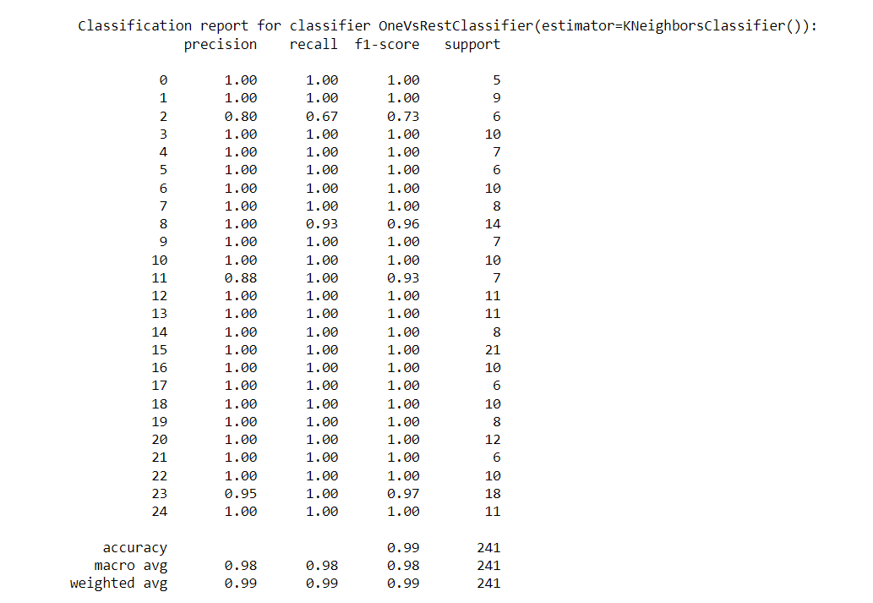
K-NN Results

Slide 13
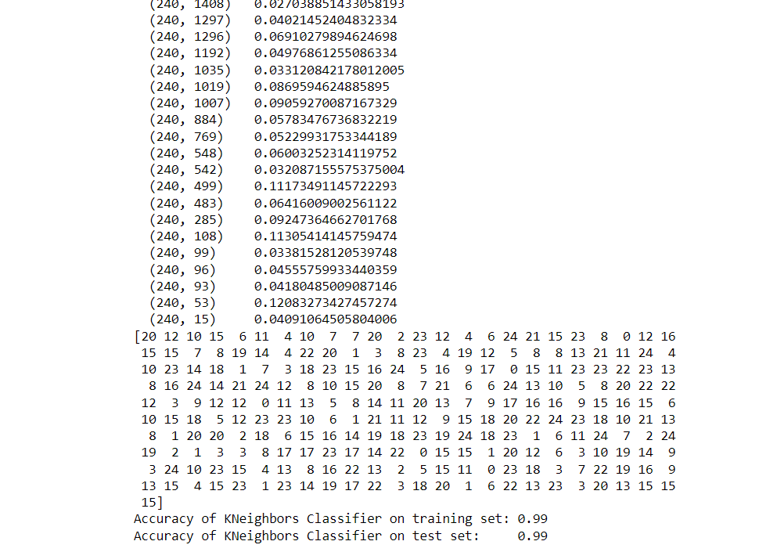
K-NN Results (continued)

Slide 14
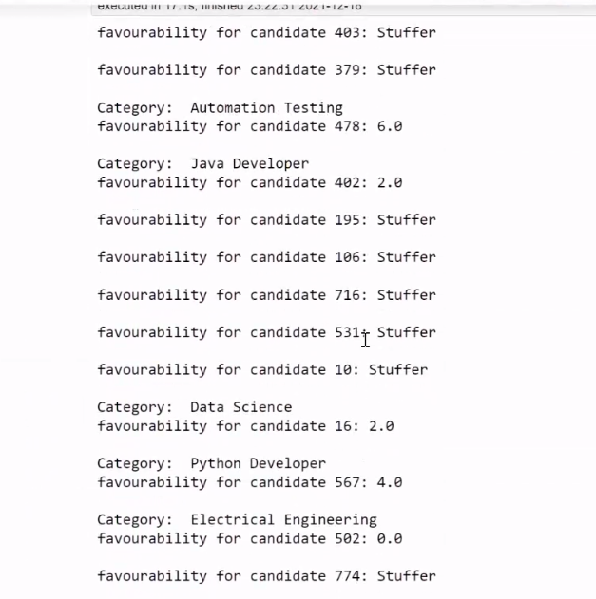
K-NN Results (continued)

Slide 15
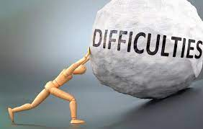
Difficulties
1- Hard to process (text form), which will affect:
a- detecting outliers
b- categorizing data
c- cleaning impurities
2- Difficult to recognize patterns
Why? Very large size of each resume and odd symbols

Slide 16
Participation
All members contributed to every part in the project
However, some had greater contribution than the others in some parts
The contribution is as follows:
Greater contribution table
Yaman | Sultan | Shabib | Tariq
 |  | Applying K-NN
 |  | Applying SVM
Report |  | Transformations and cleaning
Presentation
Final Check (Debugging, possible enhancements)

Slide 17
Conclusion and Enchantments
Although they aren’t the best, SVM and K-NN produced a magnificent results!
Possible enhancements:
We may assign a weight for every keyword, which will enhance the process of determining the favorability of candidates. This can be done by using Neural Networks. We could also use a window instead of a keyword of variable length and assign a weight for it.
We could use gradient decent to optimize the number of keywords and skills for SVM.

Slide 18

Thank you.
Group 3

